Slide 1
Team Epsilon
Team Members:
∙ Thomas Zachry ∙ Diane Chin ∙ Randy Thien Cao ∙ Charlie Pan ∙ Shayan Raza

Slide 2
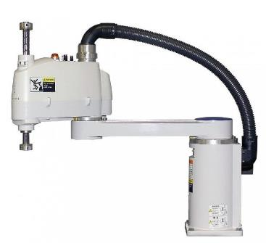
Project :
Scara Robot

Slide 3
PROGRESS
Assembly in progress
Understanding code of computer vision for different processes.
C.A.D. designs for 3D printing mounts
Early stages of UI design

Slide 4
Sprint goals
Understand Robot Operating System
SCARA Kinematics
Understand Computer Vision
SCARA Fabrication

Slide 5
Sprint Backlog
Task | Mon | Tue | Wed | Thur | Fri | Sat | Sun
Learning Robot Operating System | 4 | 2 | 6 | 3 | 8 | 6 | 4
SCARA Kinematics | 3 | 2 | 4 | 4 | 5 | 6 | 2
Learning Computer Vision | 3 | 2 | 3 | 4 | 5 | 2 | 2
SCARA Fabrication | 2 | 4 | 2 | 4 | 4 | 6 | 6

